Slide 1
Notes:
<< Be chill, conversational, smiley >>
UP
This is extremely intimidating. Going up against all the seasoned speakers and accomplished engineers talking at this conference, It’s a healthy ego haircut. What I’ve done in my life does not even compare.
Thankfully, I’m not here to tell you about some hardcore tech that I’ve invented. I’m mostly here to entertain you. And I’m hoping you learn a thing or two along the way.

Slide 2
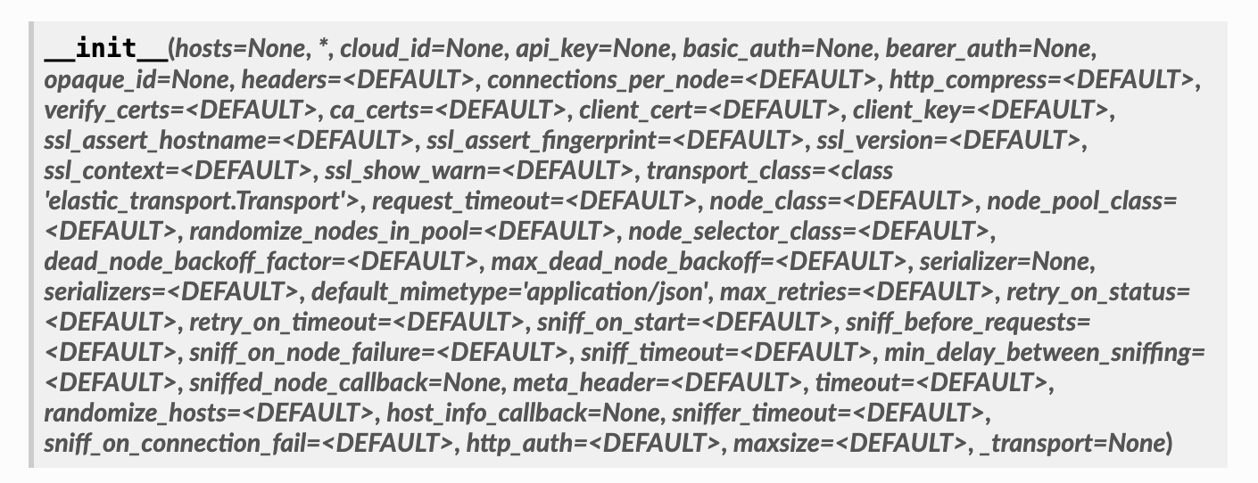
Do we need better design?
Notes:
UP
Show of hands, who’s used a function that looks like this? 🙄 Oh I’m sorry.. 😄
This is a function from a very well-known ORM that a lot of you have probably used.
And no, it does not get better as you scroll further through the docs! 😄

Slide 3
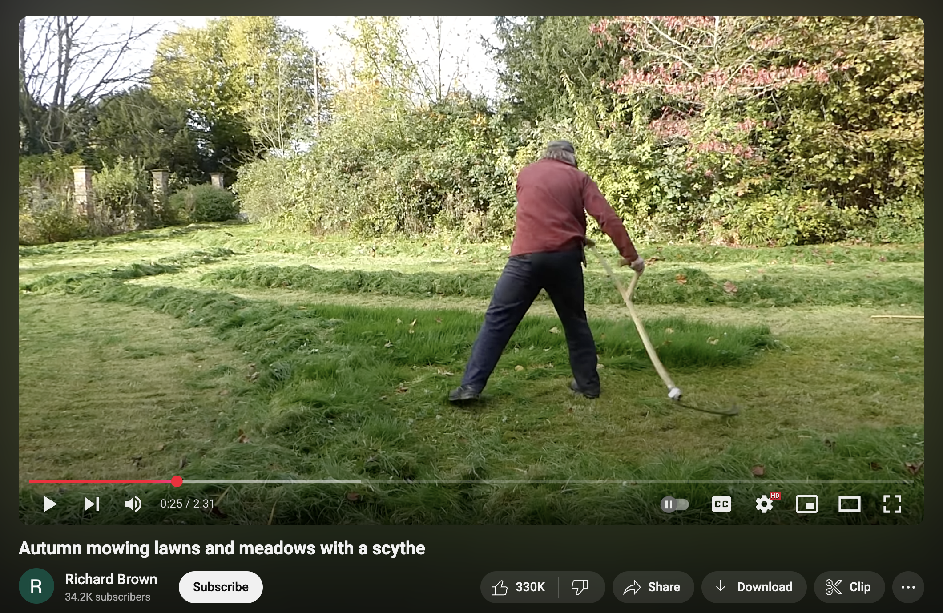
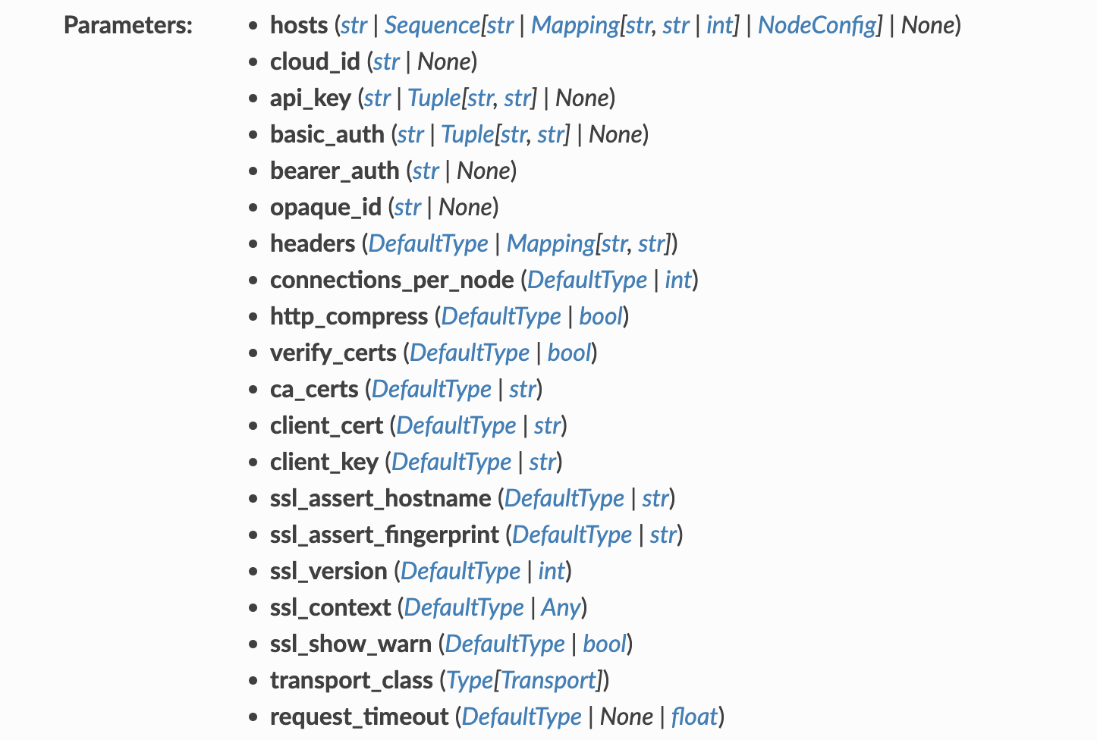
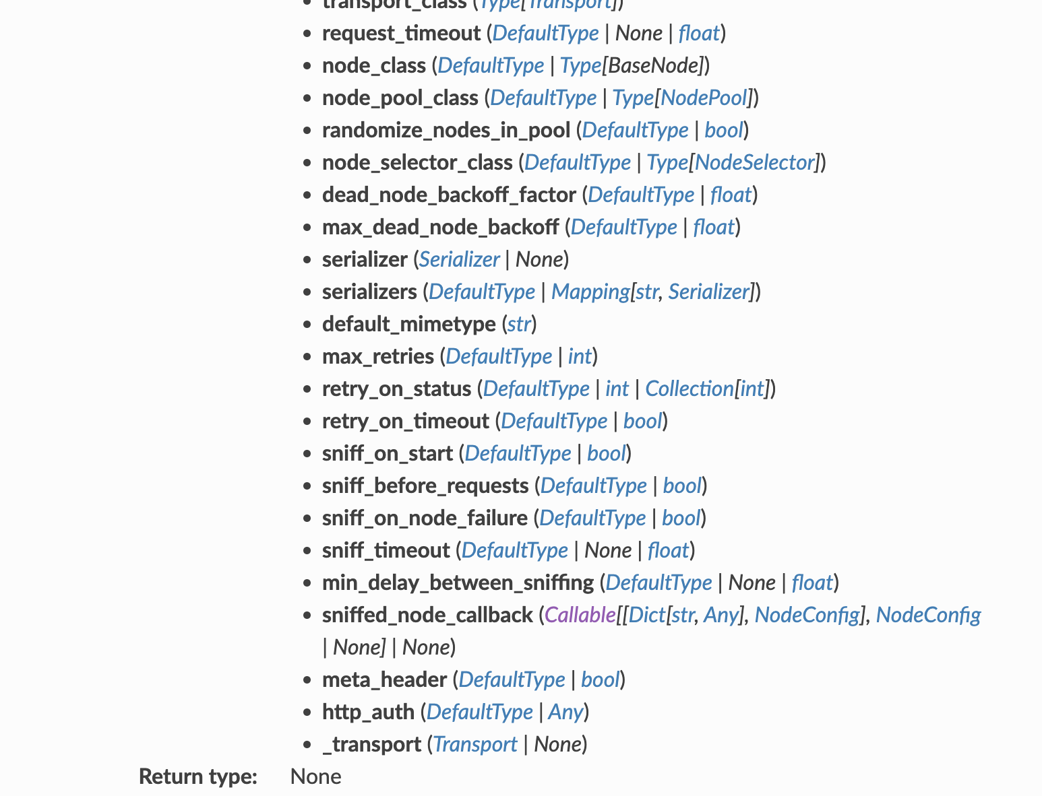
Do we need better design?
Notes:
UP
This was just a natural evolution of what started off as simple code that got the job done. People kept adding to it over time, and it got to this point.
We can’t really judge grass for over growing. Just like we can’t judge project requirements from evolving over time. But at some point, we must maintain them to keep them usable and in good shape.
This is where garden tools and software design patterns help. Mowing the lawn with an electric lawn mower is a lot easier than doing it with a scythe. Even though scythes are making a comeback on Youtube apparently. It’s pretty nice to watch, not gonna lie.

Slide 4
What are we doing?
Exploring a problem & designing a solution
Iterating on the design together
Gain some tools
Notes:
So today we’ll be exploring a problem, and designing a solution that satisfies us.
We’ll be thinking about the design process together and judging each design we come up with.
By the end of this talk, you’ll go home with a couple more tools in your tool belt, some extra experience with designing good code, and a reminder to definitely check out YouTube videos of people mowing their lawns with scythes.
TODO: Do we not want to mention functional options?

Slide 5
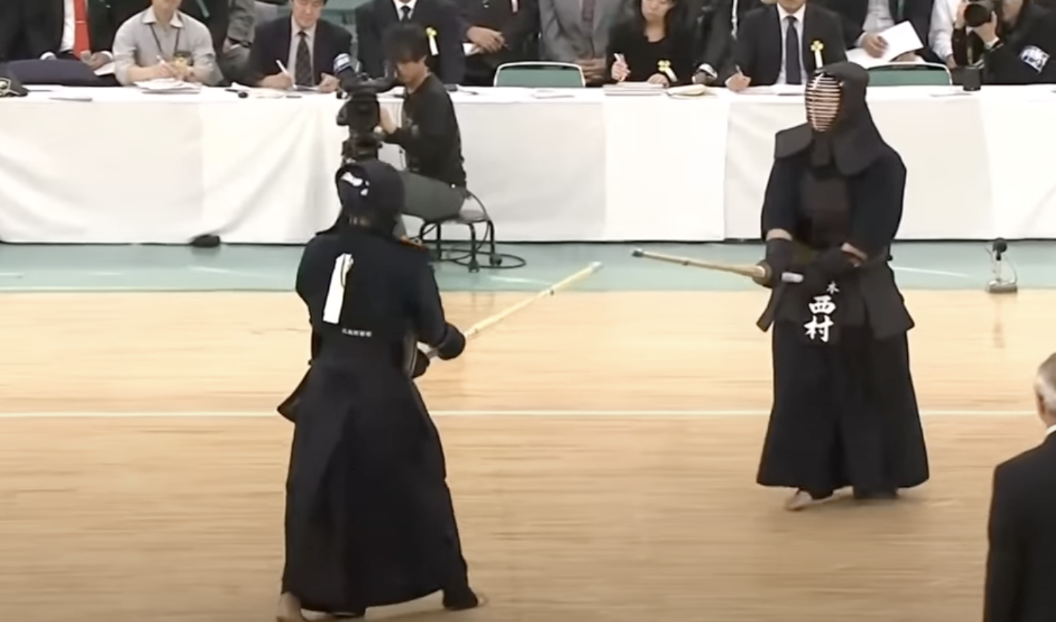
whoami
Rami, fullstack engineer specialising in AI
OS Maintainer of DataLine (1200 ⭐️) and Pet (4800 ⭐️)
Saturdays are weird
Notes:
I think it’s time I introduced myself 😄 I’m Rami, a full stack engineer specialising in AI. I’ve been designing solutions like the one we’re about to work on for a while, and across a lot of domains.
I’m also an open source maintainer of a few projects, notably Dataline: an AI-driven privacy first platform for data exploration and visualisation. Think ChatGPT code interpreter but local and connects to your DBs safely. And Pet, which is a simple command-line snippet manager written in Golang. I’ve used it every day for years before I very randomly became its maintainer!
And on Saturdays, you can spot me screaming while wielding a shinai. Kendo’s really fun, I can recommend it! And just yesterday actually, some friends I train with in the Netherlands got 3rd place in the European championship! SO I’m extra happy today.

Slide 6

First, a story
Sam
Document Analysis service
Build a python client, text files only
Notes:
Today I’m going to tell you the story of Sam, a smart engineer and good designer.
Sam’s company introduced a document analysis web service. It supported all kinds of documents as well as OCR. OCR is optical character recognition, or extracting text out of images.
Sam was tasked with building a simple python client for interacting with this service. The only requirement was to support text files, so none of the advanced service features were needed yet.

Slide 7
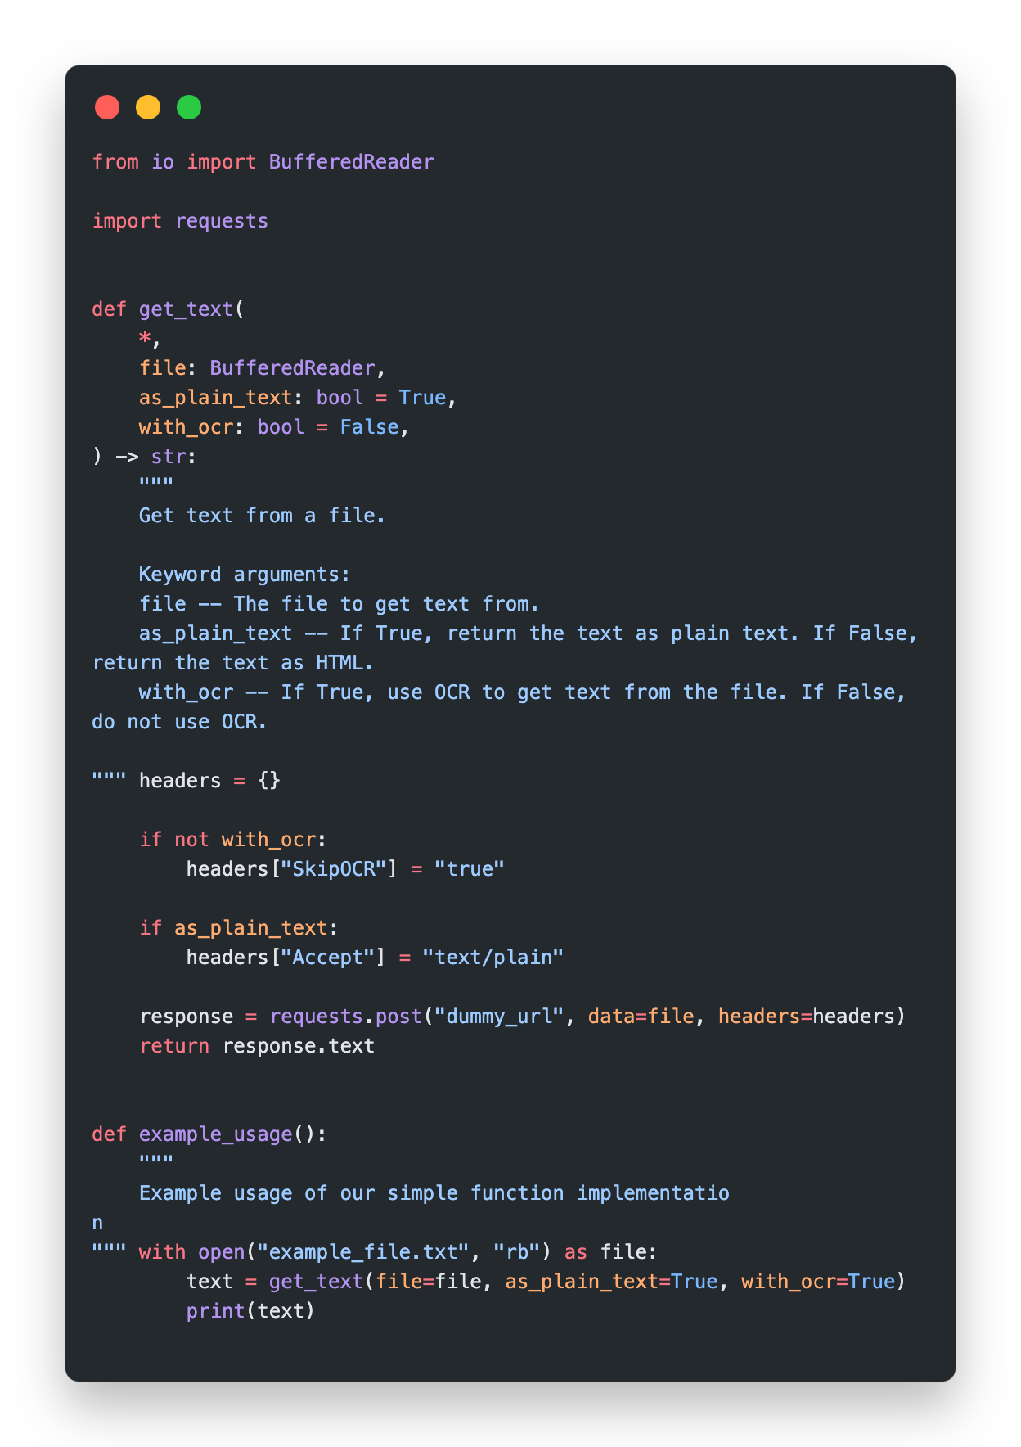
Start simple
Notes:
Sam takes a look at the web service API and creates a simple function to call it.
(Explain code)
Simple right? Gets the job done. Given the requirements, this is a great design in my opinion.

Slide 8
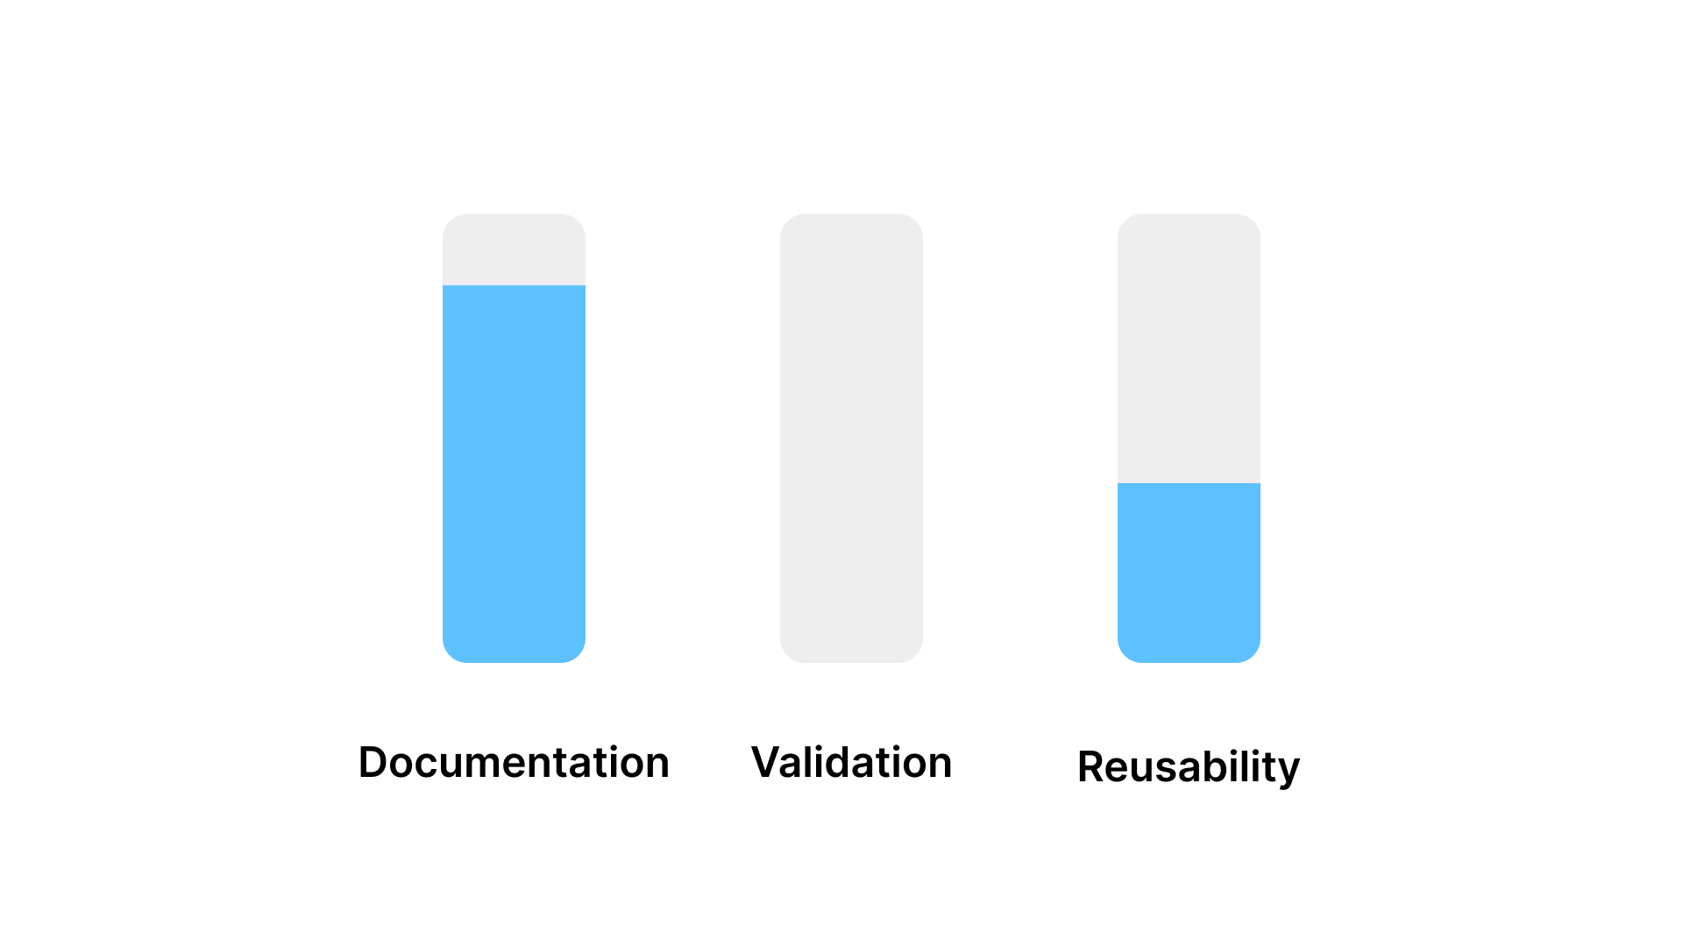
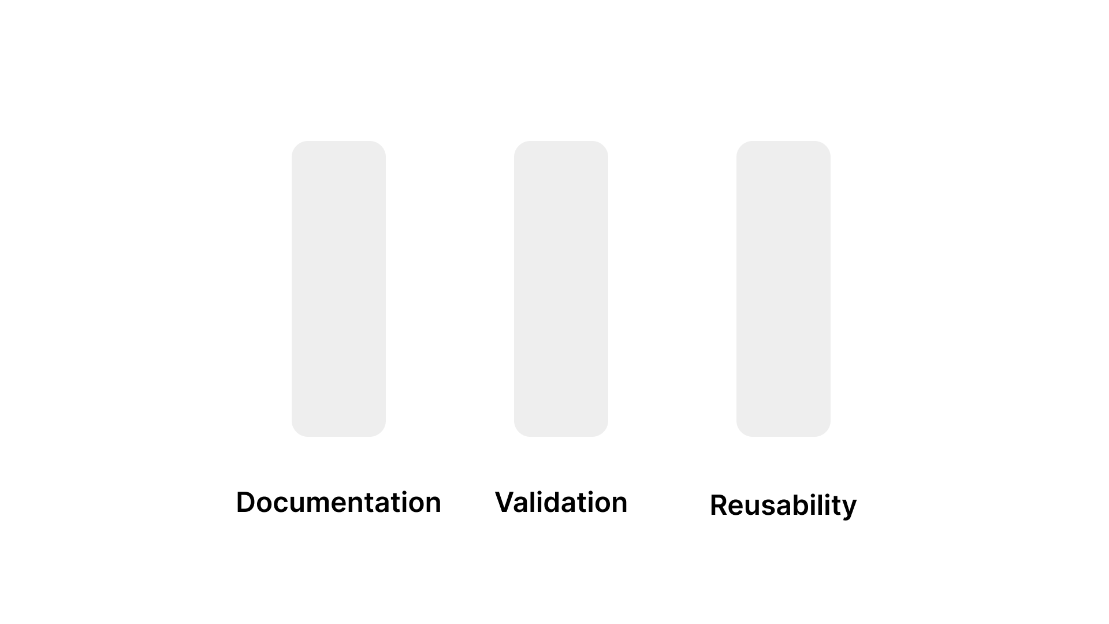
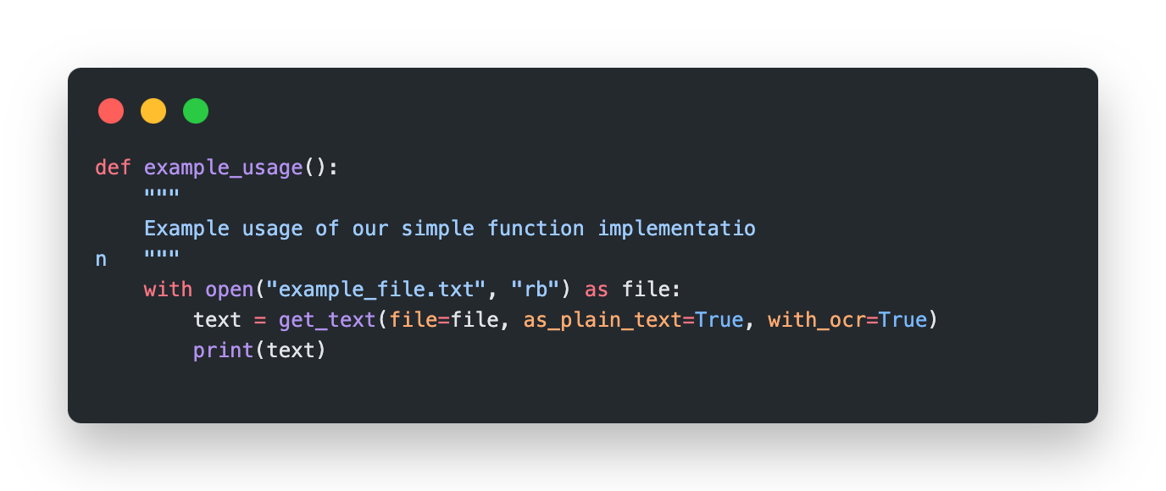
Code Review
Notes:
I’m going to introduce a little activity we’re going to do together a few times throughout this talk. I call it crowd sourced code review.
We’re going to judge this code together along 3 dimensions - docs, validation, and reusability. If you think the design does well against a dimension, raise your hand. If you think it’s bad, do nothing. At the end, I’ll show you what I personally thought it scored and why.
We can’t really quantify code designs as they’re art, as Nicholas pointed our this morning, but for the sake of this presentation we’re going to accept this over-simplification.
For this first one, I’ll show you the code again since I just introduced this, but in the next iterations I want you to try and think about this as we go through the code.
SHOW CODE We don’t have validation in this code chunk, so we can ignore that for now.
QUERY AUDIENCE
I think this is a pretty good design. Simple, docs are good, it’s easy to use, and we don’t have validation yet.

Slide 9
More, more, more
Lots of additional options needed
Let’s keep it simple and extend
Notes:
Sam delivers his work, and everyone is happy. But a few weeks later, to no one’s surprise, the project manager comes back and asks Sam to extend the client some more.
“We now need to support PDFs and images, add timeouts for long analyses, find the bounding boxes of the extracted words, and more.” He said.
So Sam decides to start simple and extend his function. Even though he risks creating a function like the one I showed in the beginning, but it’s the natural next step.

Slide 10
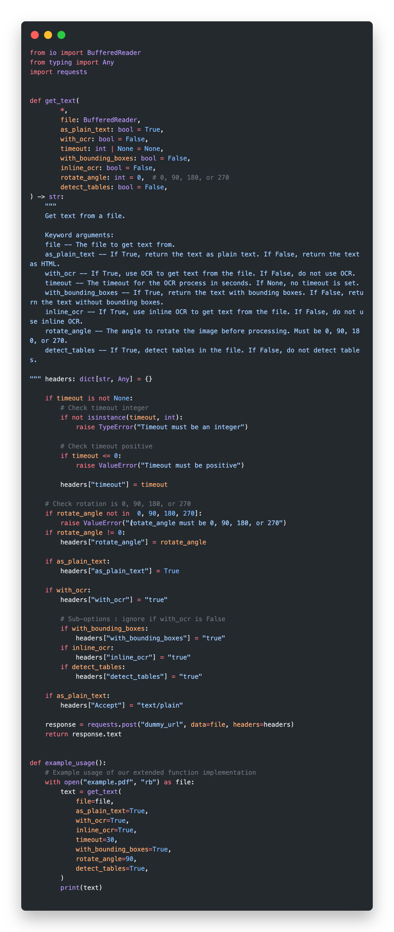
Extension
Notes:
Walk through code, don’t comment on it yet.
Notice the sub-options, complex validation logic

Slide 11
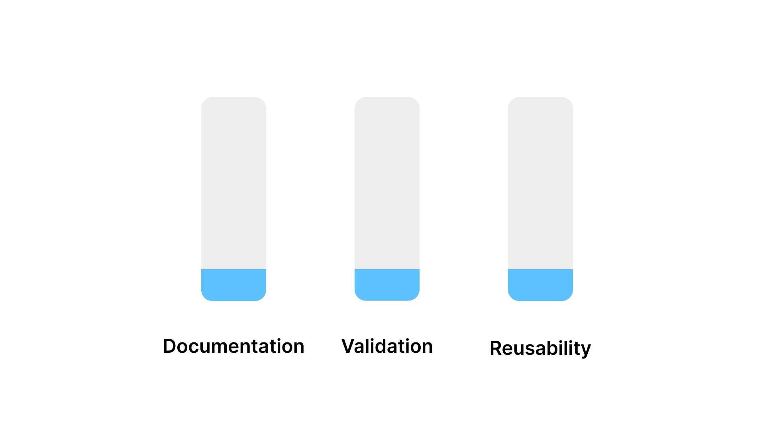
Code Review
Notes:
Code review time. What do you guys think of the docs? Validation? Reusability?
…..Wait….
The signature is pretty big, we don’t really understand what those args do directly
The docs are also big, not very readable, specially not in an editor’s autocomplete popup
The body mixes validation with construction, and is growing with the number of arguments. In reality we might have many more.
Sam doesn’t like this at all either. It breaks the golden principle!

Slide 12
Don’t leave things worse than you found them
Notes:
WATER BREAK
This principle is essential to living well. From writing good code to keeping your kitchen clean, it all goes back to the same thing, a mentality of caring for things, even if you don’t feel like it sometimes. If you finish dinner and leave your plate in the sink, it’ll be 10x harder to clean the next morning. Either pack it in the dishwasher, or wash it directly. Just don’t leave the kitchen in a worse state than you found it. If this is followed often enough, you’ll pretty much always be in a good state.
Our code review proved that this simple extension was qualitatively worse in quality.
But we can improve this with some work! So Sam decides to iterate on this.

Slide 13
Iterate
Improvement ideas:
Separate validation and construction
Create a reusable object of options
Get documentation per argument
Notes:
We can improve the validation by separating it from the construction logic. Or even better, using a validation library.
We can improve reusability by turning the options into an object that gets passed into functions.
It would also be nice to get documentation per argument optimally - current version is not readable.

Slide 14
Notes:
We’re sitting here talking about bad docstrings but I should remind you: This did not even have a docstring 😁 So we’re good, even if this is imperfect.

Slide 15
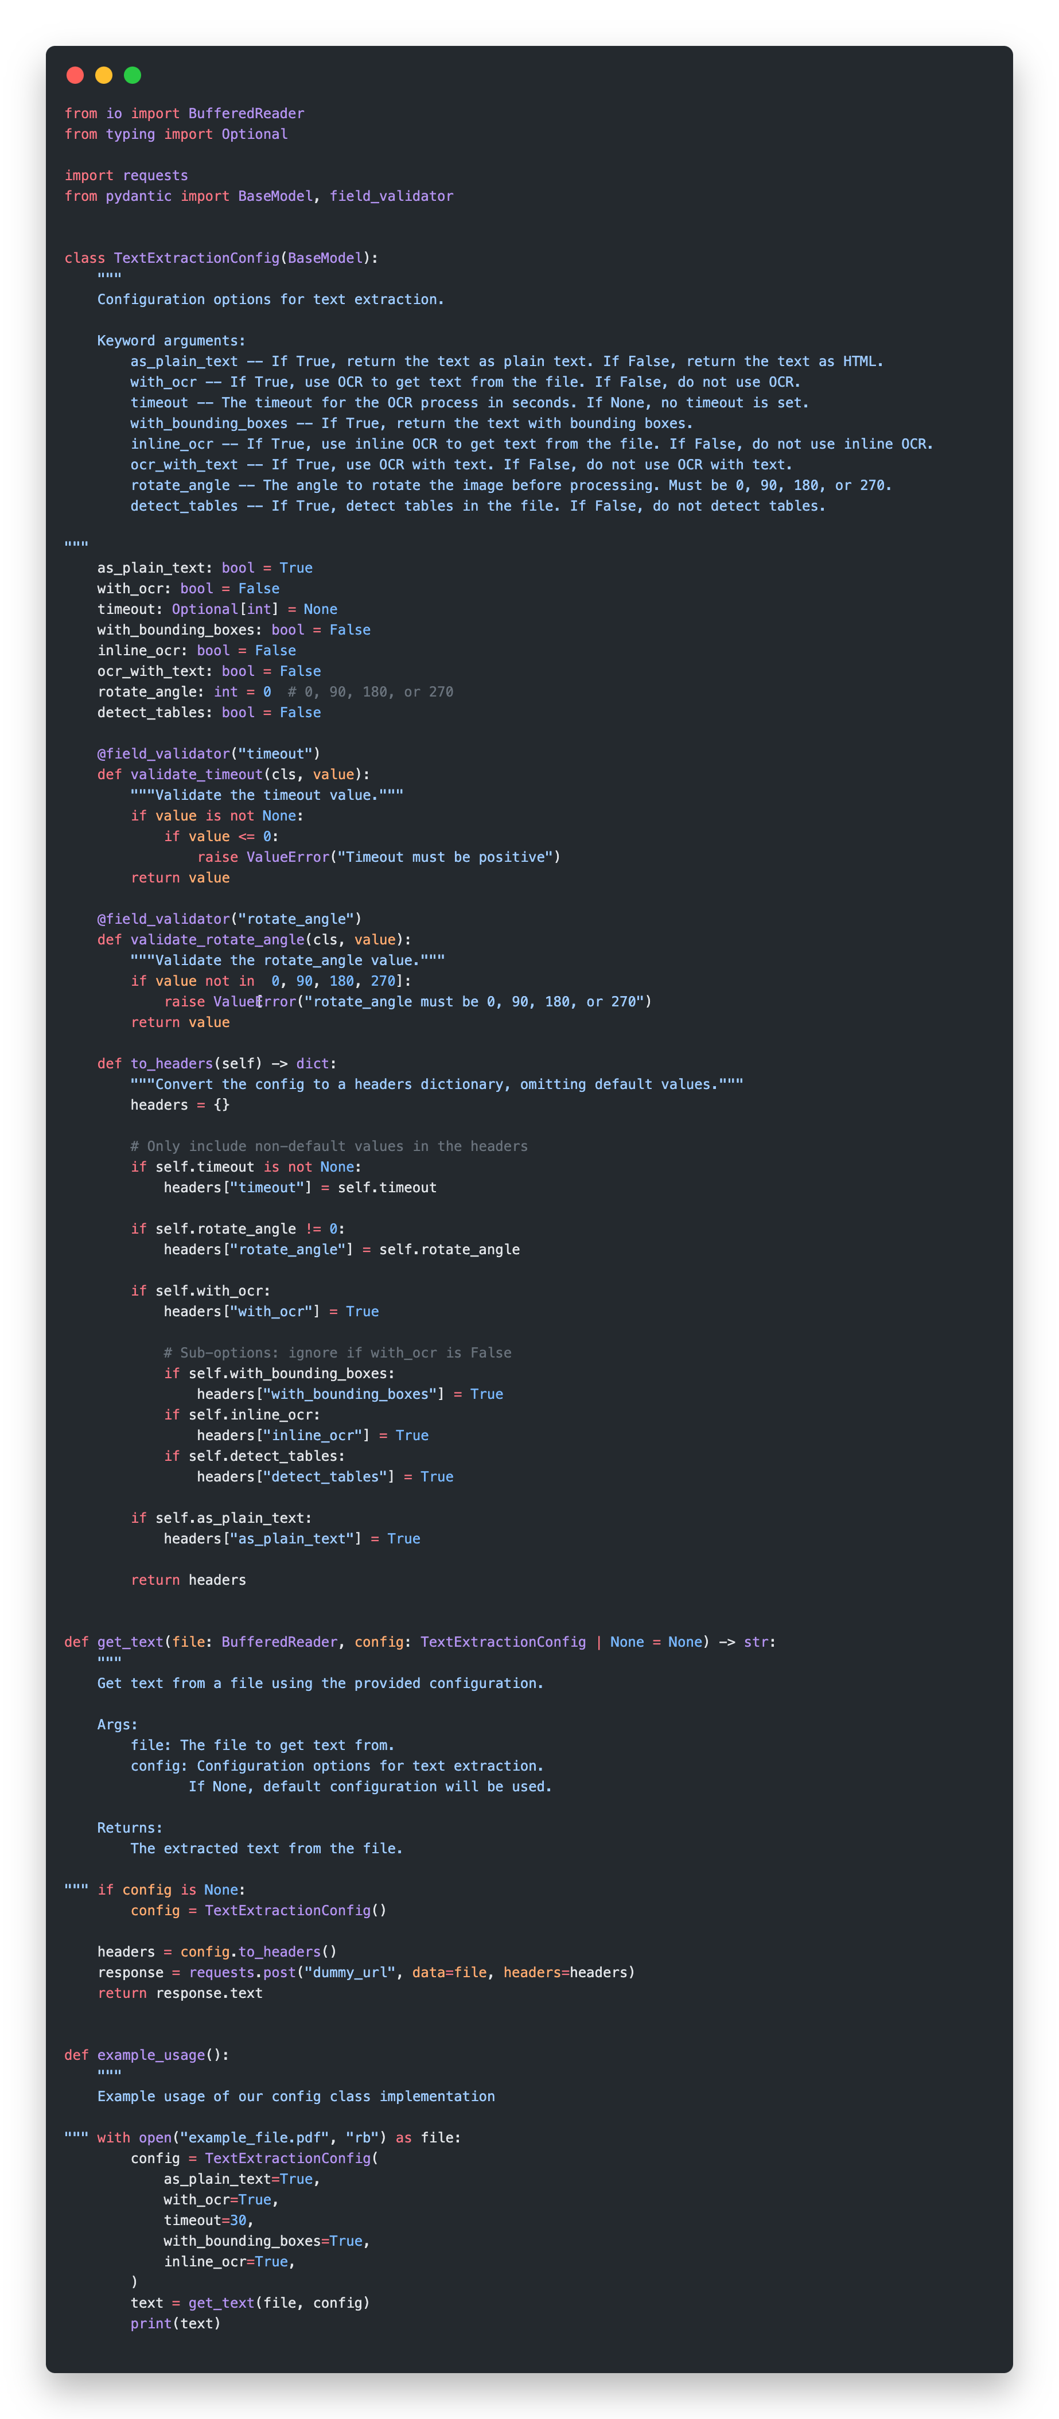
Config classes
Notes:
Sam thinks of an idea that will for sure tackle one of the improvements, and decides to try it out.
Why don’t we use Pydantic models to handle the validation for us?

Slide 16
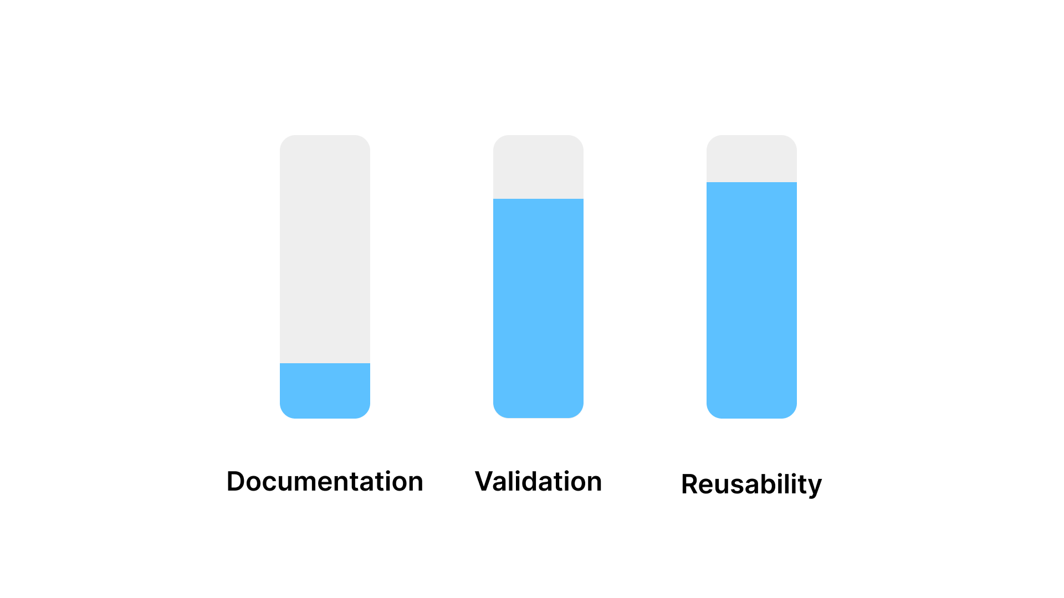
Code Review
Notes:
Code review time. What do you guys think of the docs? Validation? Reusability? ….Wait.
Validation is much better - we could use Pydantic to an even further extent if we want but I kept it simple for illustration.
Reusability has also improved - config is now just an object.
Docs are kind of the same still, just one big docstring we have to read through when instantiating the class.

Slide 17
Can we do better?
Notes:
————WATER————
So, this is good but it’s still lacking. It’s unfortunate to have a solution that doesn’t self-document well, it’ll make it much less dev friendly.
Coincidentally, Sam is also a Go developer, and there’s a standard solution to this problem in Go actually. <it’s pretty interesting to see there, weird that Python doesn’t have an equivalent standard! It’s called functional options. Options because it deals with options or parameters. Functional because,,,,,,,,, well,,,,,,,,, you’ll soon find out. But you know what, I’ll give you a spoiler: It has nothing to do with functional programming!
SO he wonders if he could translate that code to Python and reap the same benefits. To explain what it is, let’s look at the end result first.

Slide 18
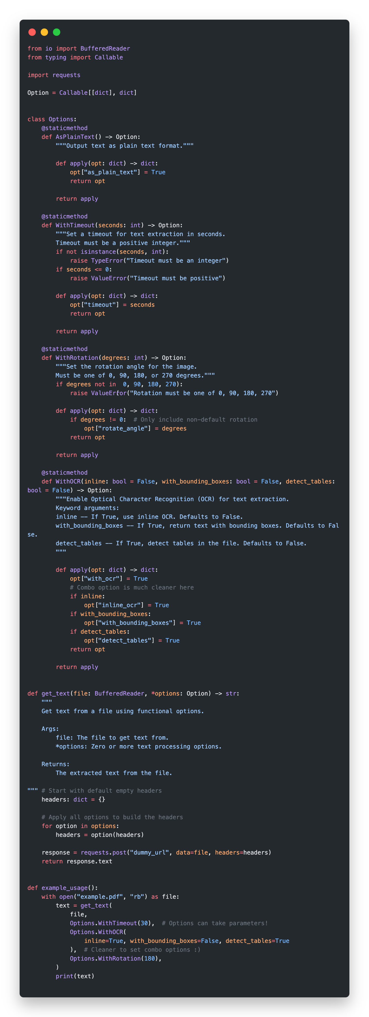
Notes:
For the usage, each option is now a separate function! This means they get their own docstrings - so big improvement to the docs there.
This also means we can ‘group’ related options, like the OCR specific options!
The definition of these functional options is a little weird - we have to return a callable. Sam sees this as a downside as it increases complexity.
You can see the validation is clean, still separated from the business logic.
Applying them is straightforward - just loop over all the options and call them.

Slide 19
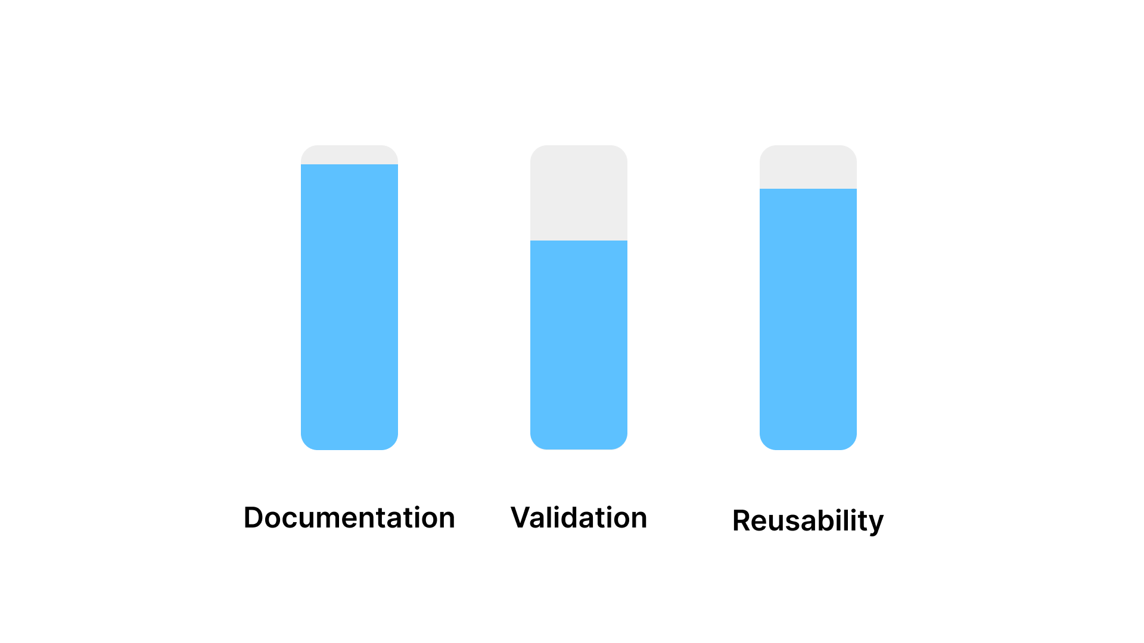
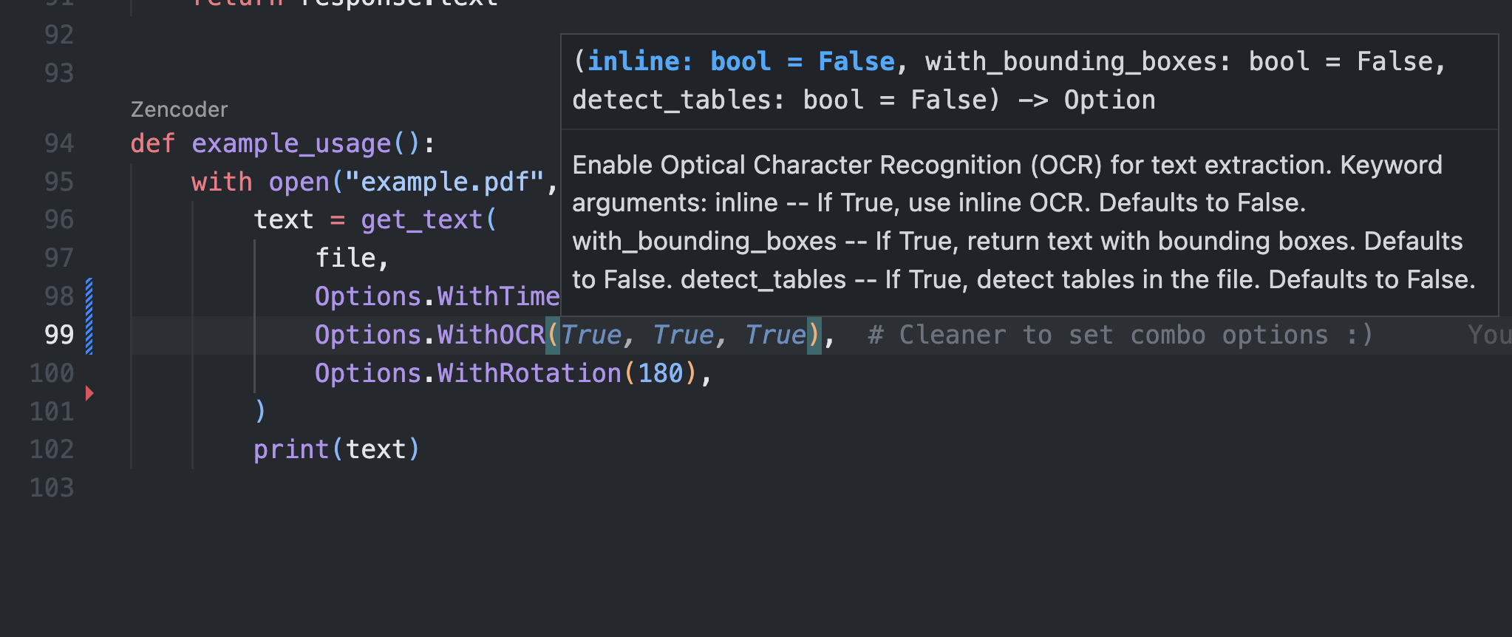
Code Review
Notes:
You know what time it is by now! What do you guys think of the docs? Validation? Reusability? …..Wait.
SHOW RESULTS
Well I think the docs are so good, I had to attach a screenshot of editor autocomplete for you.
Validation is maybe a bit less good since we don’t take advantage of Pydantic anymore
Reusability has also slightly improved in my opinion, now each option is defined separately. Although it’s not a single object anymore, so…, !debatable!
There is one thing about it though - that we’re not covering within our metrics. It’s just not very Pythonic is it? Well that’s the thing about design - it can’t be fully described with metrics. It’s a craft.

Slide 20
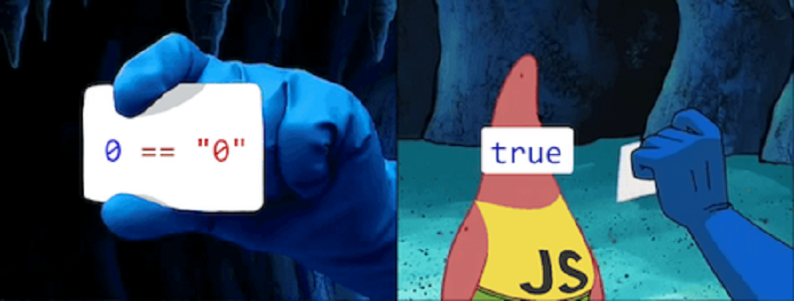
Notes:
Javascript has given us a lot. I’m saying this,,,,,,,,, only half sarcastically maybe. But one thing it’s especially recognised by is method chaining. You just see it everywhere.
Sam being a Javascript nerd as well, his functional options implementation made him think of method chaining.
It’s also quite common in Python, but relatively less so. I think some of you know where I’m going with this.

Slide 21
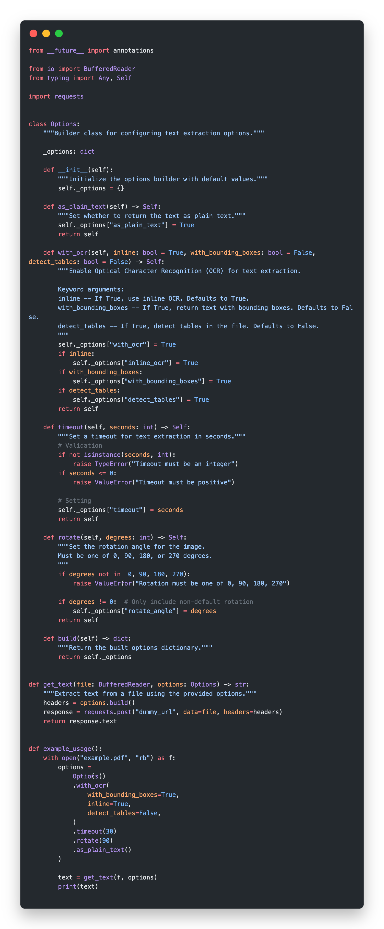
Builder & Chain
Notes:
Builder and chain is a pattern that allows us to ‘build’ an object incrementally by chaining method calls together.
SHOW USAGE SHOW INTERNALS
The options are stored in an internal state instead of external, as we had with functional options.
Each method just modifies this internal state in-place. The rest is the same as functional options!

Slide 22


Methods are basically the same, so our code review should end up being the same
This is more Pythonic and simpler. This wins.
Could all Gophers be wrong?
Notes:
Sam is pretty happy with his choice! It’s simple, it’s pythonic, it’s the best iteration so far.
We can skip the code review. The methods are basically the same!
It’s also more Pythonic and simpler - I think this wins.
But this gets him thinking, why is Functional Options even a thing in Golang? Why not just use builder and chain there? Could all gophers be wrong? SHOW GOPHER
Whenever you ask yourself a question like this, it’s always better to assume that you’re the wrong one.

Slide 23
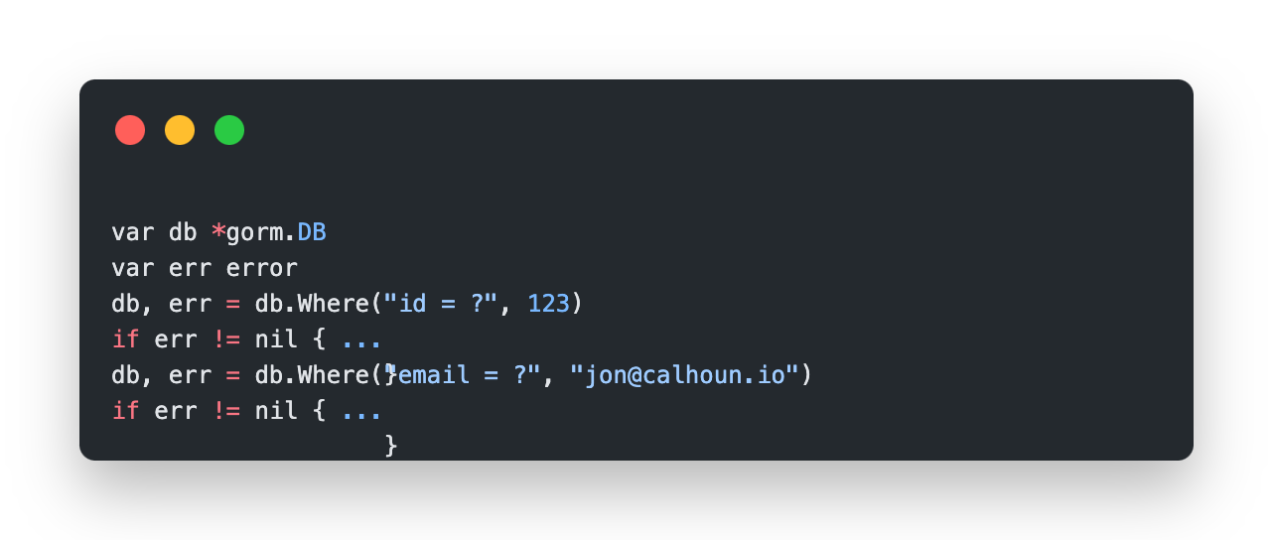
Why is Go different?
Error passing
Notes:
- At this point, Sam was about to get fired. His product manager learned that he spent a week iterating on this code in a perfectionist attempt. Just kidding. This is your friendly reminder that time is always a constraint! We’re never designing in a bubble. (TODO: Smoother transition).
In Python, we would simply throw an exception. In Go, the standard is returning the error manually and handling it manually.
There are ways to get around this, but as you can imagine, they all come with downsides. And this is why functional options is the standard for handling options in Golang! I just wish we had a similar standard in Python, which is still very wild west for no good reason. Well maybe the reason is it’s not as much of a dictatorship as Go is.

Slide 24
$$\sum_{i=1}^{n}{i}$$
Notes:
TO SUM THINGS UP, we’ll quickly look at a side-by-side comparison of how our code evolved.
And In a moment,,,,,,,,, we’ll have some time for a few questions. So start thinking about those!

Slide 25
Simple Function
Notes:
We started off with simple requirements, and created an equally simply design - a function.
That worked out great, any more complexity and it would have been bad actually.

Slide 26
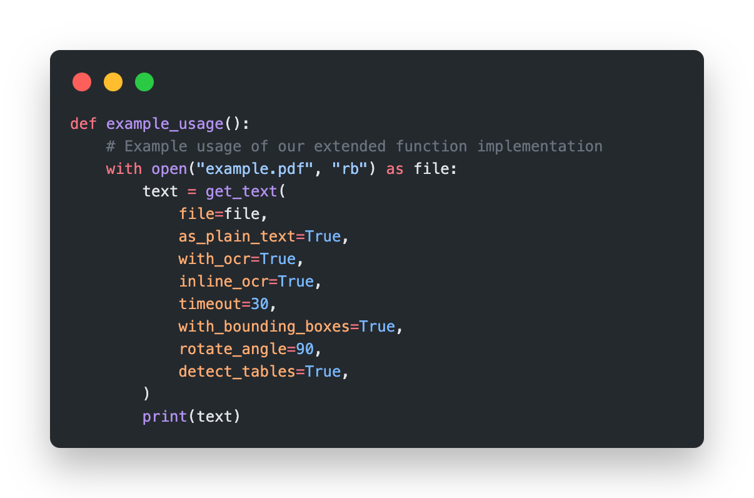
Extended Function
Notes:
Then our requirements evolved, and we had to support many more options.
So we tried extending our initial solution first, and that turned out to be quite bad.
But it allowed us to see what needed improvement, and propose a better design based on that! So it was a necessary step in a way.

Slide 27
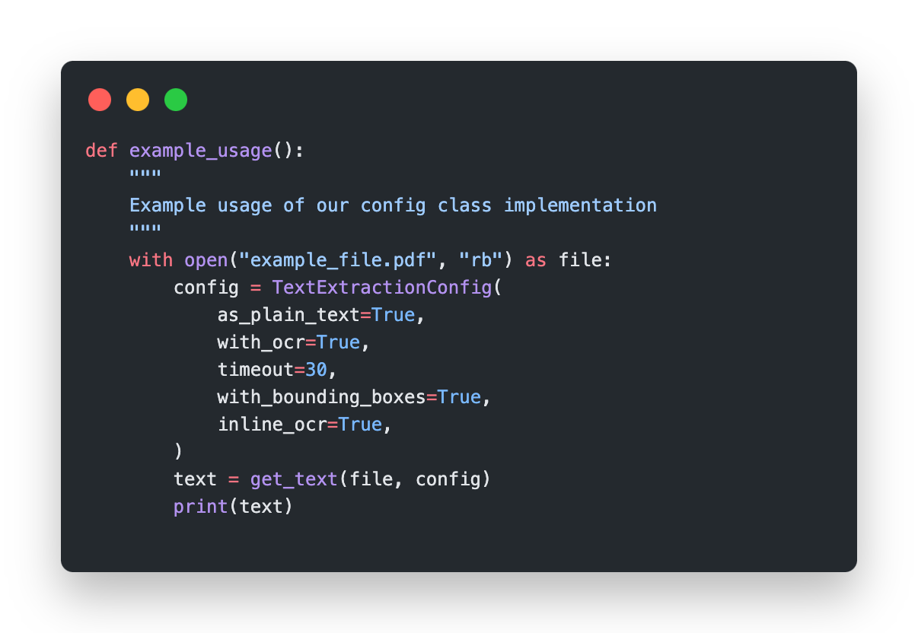
Config classes
Notes:
Config classes improved things a little. Validation was cleaner, the solution was more reusable, but the docs were still average.
- Then inspiration struck! Borrow a concept from Golang!

Slide 28
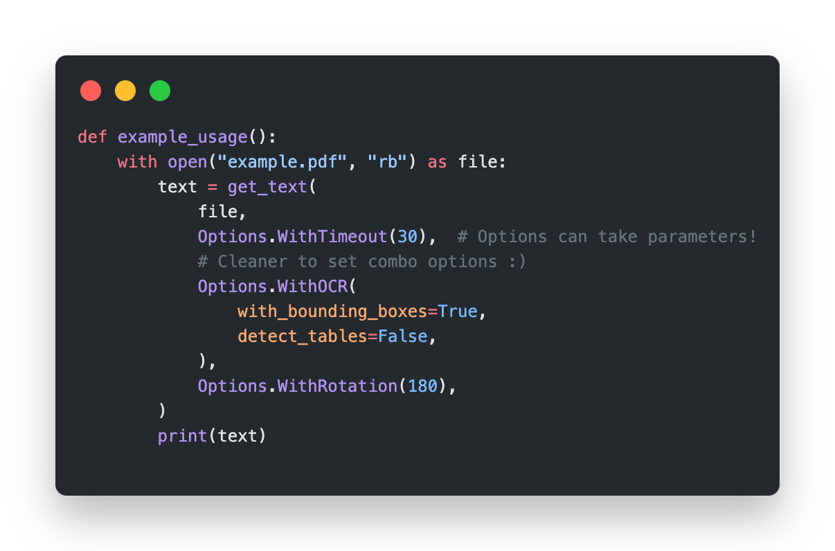
Functional Options
Notes:
Functional options seemed to perform best on our metrics.
But it still lacked something, and that didn’t really show in the metrics we chose. It seemed too complex for what it was doing.
Thankfully, we knew Javascript, and that inspired us to find an even better design.

Slide 29
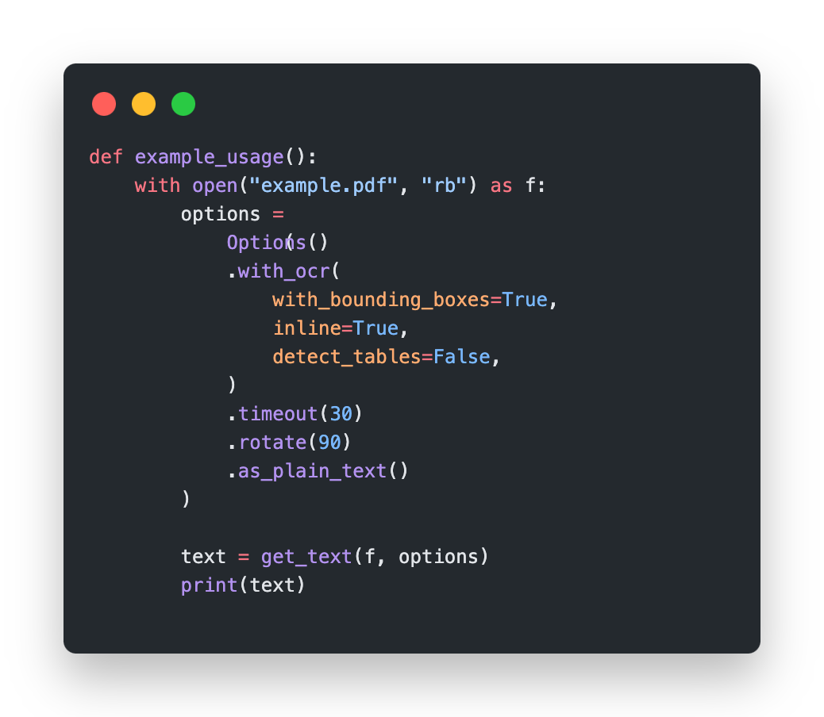
Builder and Chain
Notes:
Method chaining was a good fit here.
It still offered us the benefits of functional options, but was simpler, and more familiar in Python.
And that naturally led us to also store the builder state in a class which got us to Builder & Chain, a well known design pattern.

Slide 30


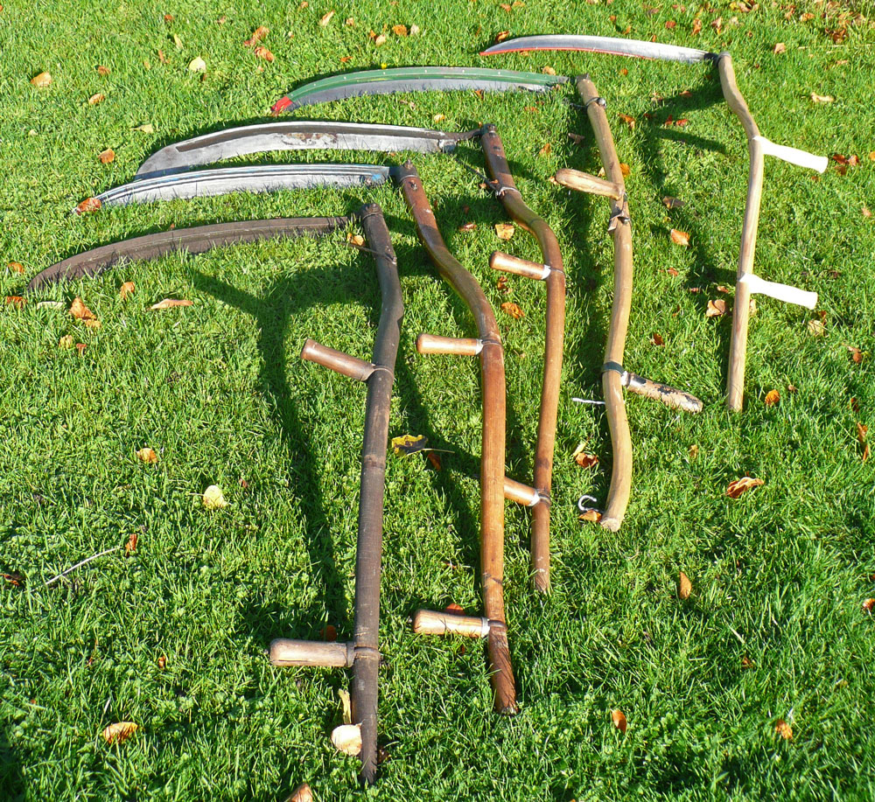
$$=\frac{n(n+1)}{2}$$
❌
✅
Notes:
So at the end of the day, combining experience from different domains gave us different lenses from which to see our design and critique it. The more you explore and be curious, the more tools you’ll be familiar with.
We should also try to avoid (NEXT) scythes in favour of (NEXT) electric lawn mowers, although it probably feels epic to wield a scythe sometimes.
*cough* CLICK x2 *cough*

Slide 31
Sources
Rob Pike - the OG creator of functional options https://commandcenter.blogspot.com/2014/01/self-referential-functions-and-design.html
Me https://www.softgrade.org/functional-options-in-python/
Jon Calhoun on why method chaining isn’t recommended in Go https://www.calhoun.io/using-functional-options-instead-of-method-chaining-in-go/
Dave Cheney on what are functional options https://dave.cheney.net/2014/10/17/functional-options-for-friendly-apis

Slide 32
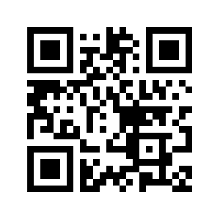



Exploring Functional Options in Python
Rami Awar - PyCon Italia 2025
Pet
Notes:
Here you can find A FEW LINKS on my Github profile to all these projects, as well as blogs and videos I’ve made.
I’ll be around until the end of the day, so please come and chat if you have anything to talk about! I’m a bit shy to be approaching others, but now you have an official invite.
Thank you all for your attention, and have a nice rest of your day!

